Slide 1
FASTMath Unstructured Mesh Technologies
E. Boman¹, V. Dobrev², D.A. Ibanez¹, K.E. Jansen³, T. Kolev²,
J.Merson⁴, O. Sahni⁴, M.S. Shephard⁴, C.W. Smith⁴ , M. Stowell²
¹Sandia National Laboratories
²Lawrence Livermore National Laboratory
³University of Colorado
⁴Rensselaer Polytechnic Institute

Slide 2
Unstructured Mesh Methods
Unstructured mesh – a spatial domain discretization composed of topological entities with general connectivity and shape
Advantages
Automatic mesh generation for any level of geometric complexity.
Can provide the highest accuracy on a per degree of freedom basis
General mesh anisotropy possible
Meshes can easily be adaptively modified.
Given a complete geometry, with analysis attributes defined on that model, the entire simulation workflow can be automated.
Disadvantages
More complex data structures and increased program complexity, particularly in parallel.
Requires careful mesh quality control (level of control required is a function of the unstructured mesh analysis code).
Poorly shaped elements increase condition number of global system which makes iterative matrix solves slower and harder.
Non-tensor product elements not as computationally efficient.
36

Slide 3
Unstructured Mesh Methods
Goal of FASTMath unstructured mesh developments include:
Provide unstructured mesh components that are easily used by application code developers to extend their simulation capabilities.
Ensure those components execute on exascale computing systems and support performant exascale application codes.
Develop components to operate through multi-level APIs that increase interoperability and ease of integration.
Address technical gaps by developing tools that address needs and/or eliminate/minimize disadvantages of unstructured meshes.
Work with DOE application developers on integration of these components into their codes.
Develop unstructured mesh version of applications.
37

Slide 4
FASTMath Unstructured Mesh Development Areas
Unstructured Mesh Analysis Codes – Support application’s PDE solution needs – MFEM library is a key example.
Performant Mesh Adaptation – Parallel mesh adaptation to integrate into analysis codes to ensure solution accuracy.
Dynamic Load Balancing and Task Management – Technologies to ensure load balance and effectively execute by optimal task placement.
Unstructured Mesh for Particle Codes – Tools to support particle operations on unstructured meshes.
Code Coupling Tools – Parallel geo./mesh/field coupling
In Situ Vis and Data Analytics – Tools to gain insight as
simulations execute.
Unstructured Mesh ML and UQ – ML for data reduction,
adaptive mesh UQ.
38

Slide 5
FASTMath Unstructured Mesh Tools and Components
FE Analysis codes:
  MFEM (https://mfem.org/): High-order exascale finite element library.
  LGR (https://github.com/SNLComputation/lgrtk): Tool Kit for Lagrangian grid reconnection.
  PHASTA (https://github.com/phasta/phasta): Stabilized finite element
  fluid dynamics code.
Load balancing, task placement:
  Jet (https://github.com/sandialabs/Jet-Partitioner/): Parallel graph partitioner that runs on most CPU and GPU systems.
  Zoltan (https://github.com/sandialabs/Zoltan): Dynamic load balancing library.
  Zoltan2 (https://github.com/trilinos/Trilinos/tree/master/packages/zoltan2): A package of combinatorial algorithms for scientific computing.
  PUMI-Balance (http://scorec.github.io/EnGPar/): A hyper-graph based parallel unstructured mesh dynamic partition improvement component
39

Slide 6
Parallel Unstructured Mesh Infrastructure
Unstructured Mesh Infrastructure:
  PUMI-General-Adapt (https://github.com/SCOREC/core): CPU based scalable conforming mesh adaptation based on local mesh modification.
  PUMI-Portable-Adapt (https://github.com/SCOREC/omega_h): Perfromant (CPUs and GPUs currently) infrastructure supporting scalable conforming mesh adaptation based on local mesh modification.
  PUMI-Pic (https://github.com/SCOREC/pumi-pic): Performance portable (CPUs and GPUs) with scalable mesh and particle data structures and operators to support particle-in-cell simulation codes.
  PUMI-Tally (to be released soon): Performance portable (CPUs and GPUs) infrastructure with scalable mesh and particle data structures and operators to support Monte Carlo neutral particle transport.
  PUMI-Balance (http://scorec.github.io/EnGPar/): A hyper-graph based parallel unstructured mesh dynamic partition improvement component.
General code coupling:
  PCMS (https://github.com/SCOREC/pcms): Code coupling library for
  exascale applications (from file based to parallel in memory).
40

Slide 7
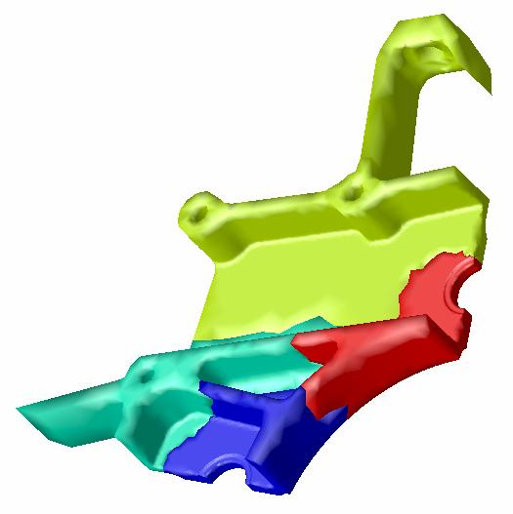
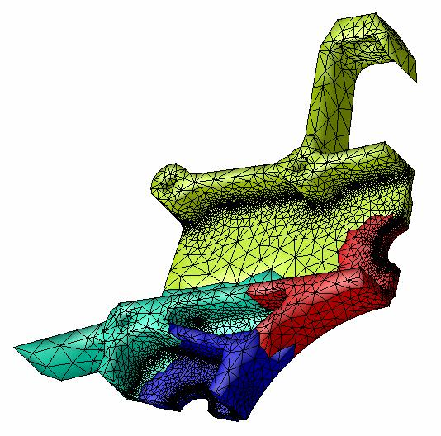
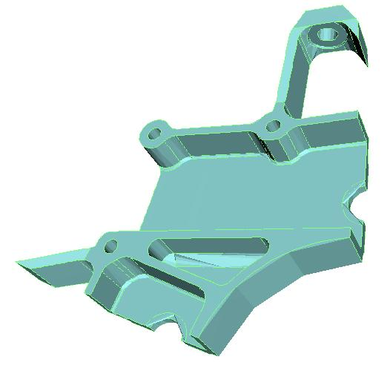
Parallel Unstructured Mesh Infrastructure
Support unstructured mesh interactions on exascale systems
  Mesh hierarchy to support interrogation
  and modification of meshes.
  Maintains linkage to original geometry.
  Conforming mesh adaptation.
  Inter-process communication.
  Supports field operations.
inter-process part boundary
Proc i
Proc j
P
0
P
2
0
M
i
1
M
j
P
1
intra-process part boundary
Geometric model
Partition model
Distributed mesh
41

Slide 8
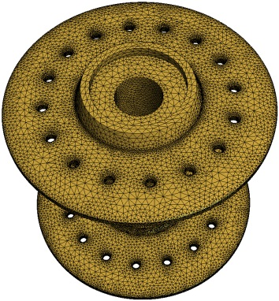
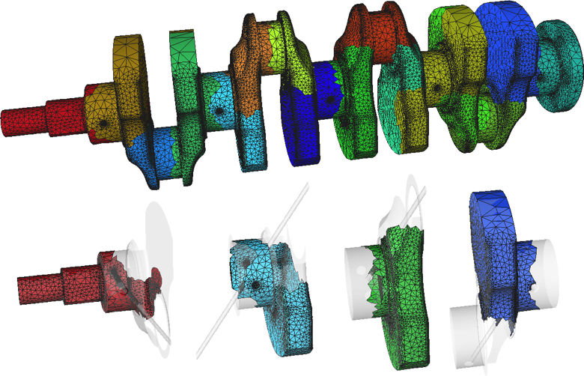
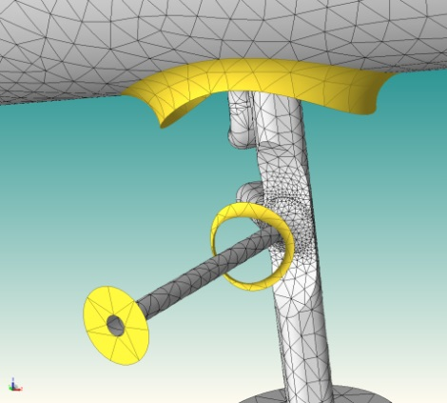
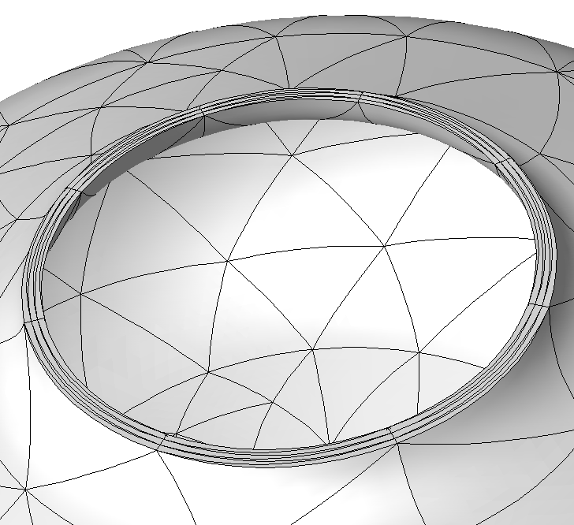
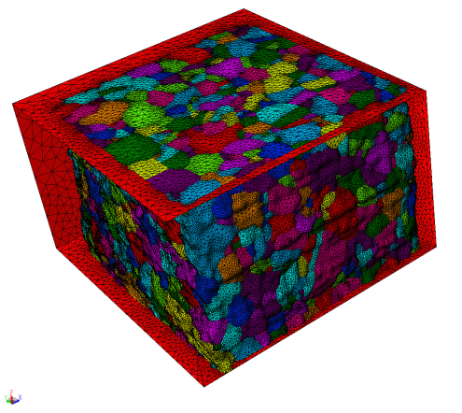
Mesh Generation and Control
Mesh Generation:
Automatically mesh complex domains – should work
directly from CAD, image data, etc.
Use tools like Gmsh, Simmetrix, etc.
Mesh control:
Use a posteriori information to improve mesh.
Curved geometry and curved mesh entities.
Support full range of mesh modifications –
vertex motion, mesh entity curving, cavity based
refinement and coarsening, etc. anisotropic adaptation.
Control element shapes as needed by the various discretization methods for maintaining accuracy and efficiency.
Parallel execution of all functions is critical on large meshes.
42

Slide 9
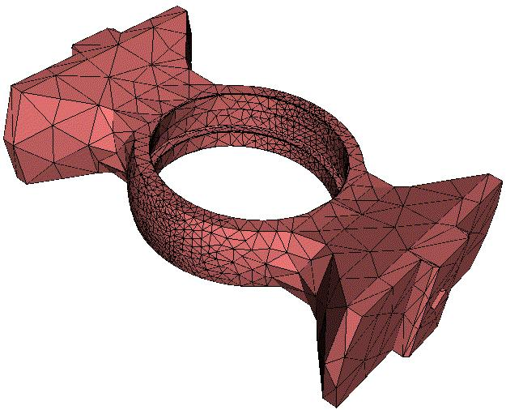
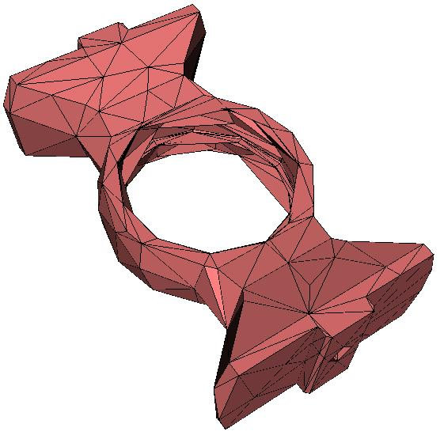
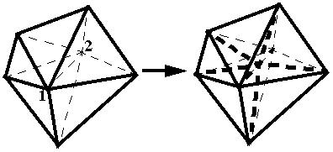
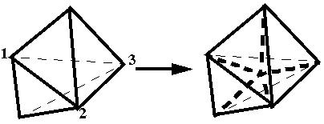
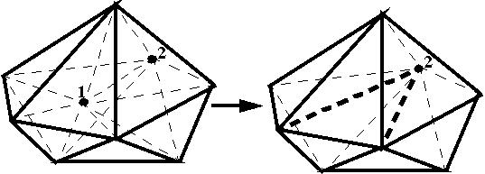
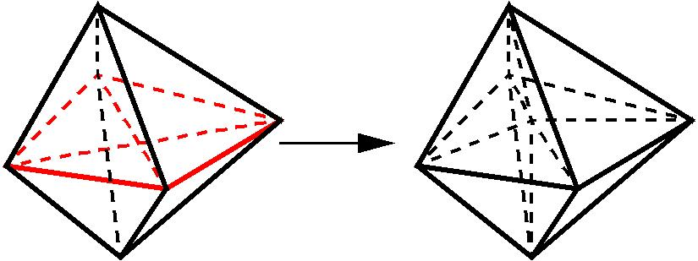
General Mesh Modification for Mesh Adaptation
Driven by an anisotropic mesh size field that can be set by any combination of criteria.
  Employ a set of mesh modification operations to alter the mesh into one that matches the given mesh size field.
Advantages:
  Supports general anisotropic meshes.
  Can obtain level of accuracy desired.
  Can deal with any level of geometric domain complexity
  Solution transfer can be applied incrementally - provides more control to satisfy conservation constraints.
Improved
geometry
approximation
Edge split
face split
Edge collapse
Double split collapse to remove sliver
43

Slide 10
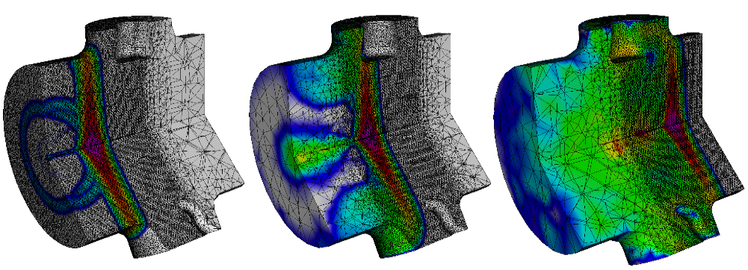
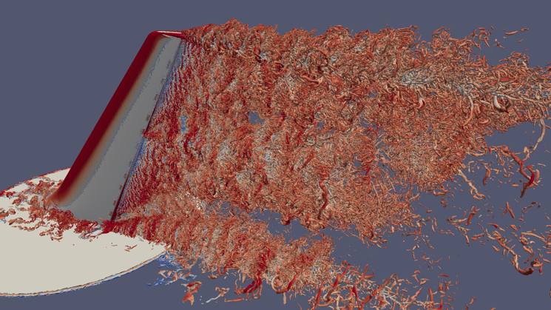
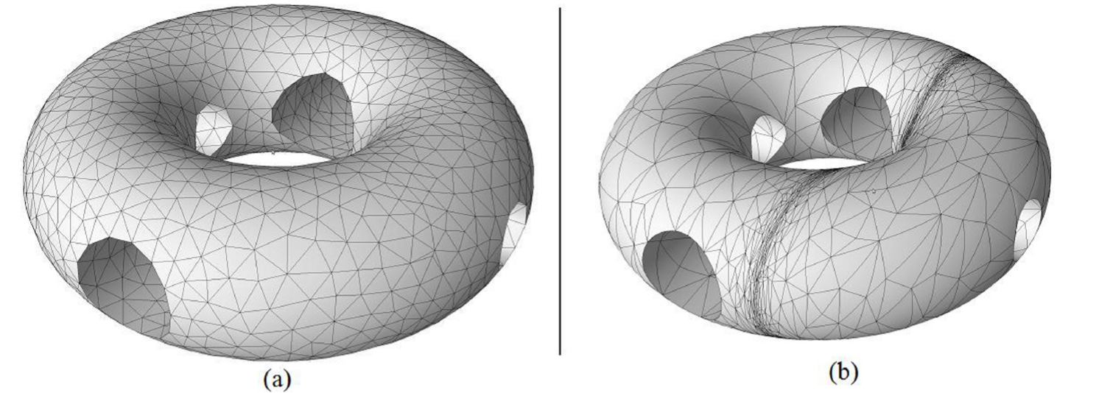
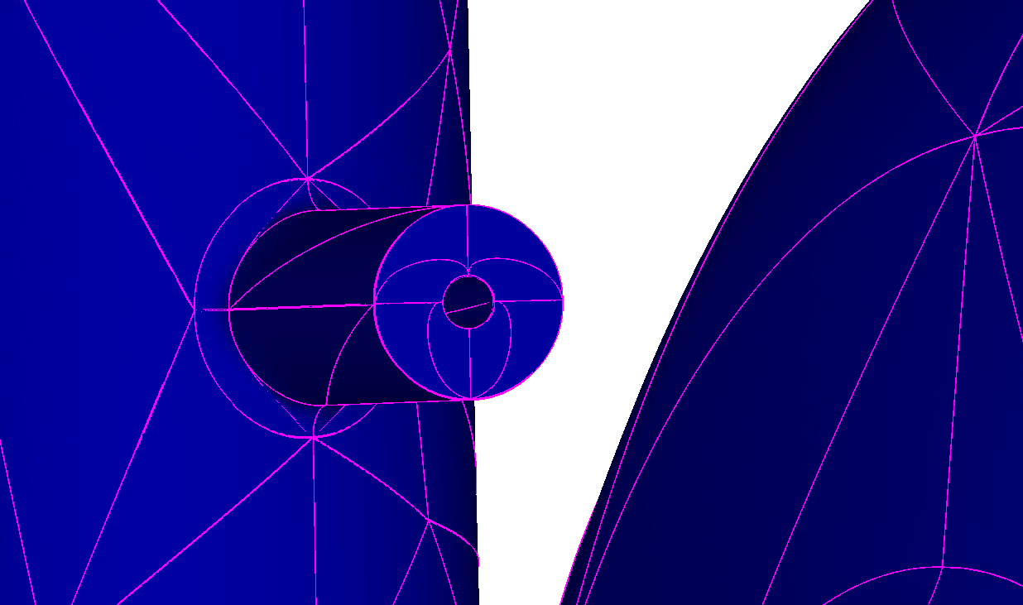
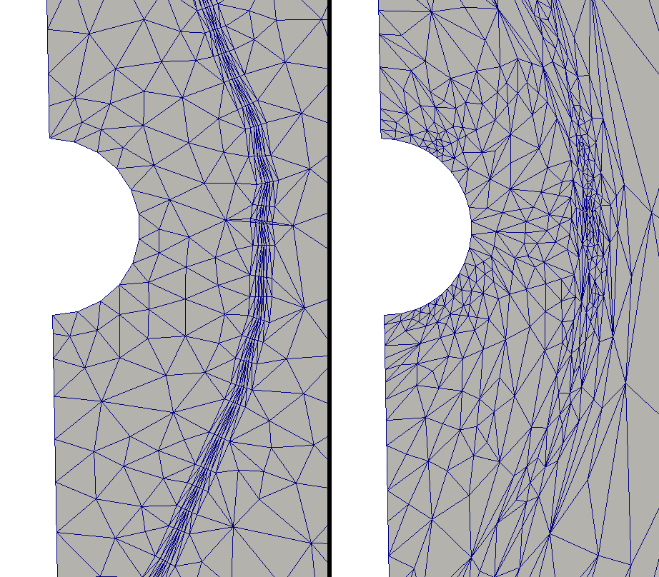
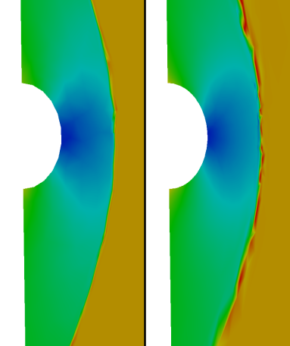
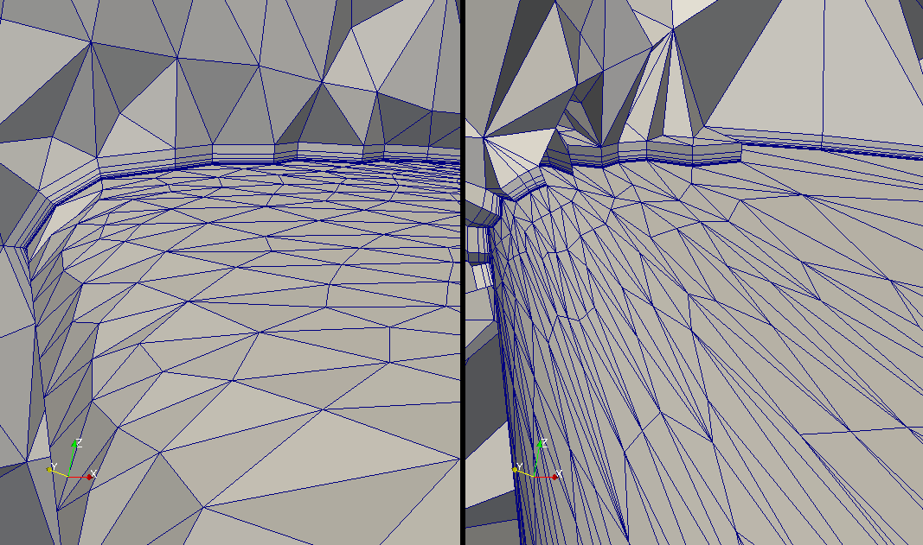
Mesh Adaptation Capabilities
Parallel adaptation of mesh with > 90 billion elements
Tracking evolving solution features
Adaptation of curved high-order elements
Mixed element topology boundary layer mesh adaptation
Automatic detection and isolation of solution features
44

Slide 11
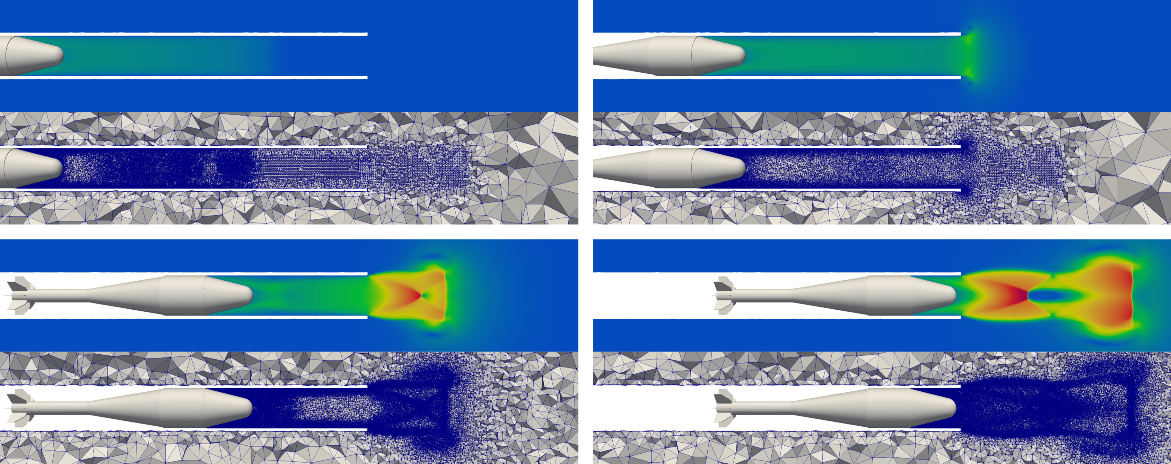
Mesh Adaptation of Evolving Geometry Problems
Many applications have geometry that evolves as a function of the results: Effective adaptive loops combine mesh motion and mesh modification.
Adaptive loop:
  Initialize analysis case, generate initial mesh, start time stepping loop.
  Perform time steps employing mesh motion - monitor element quality and discretization errors.
  When element quality is not satisfactory or discretization errors too large – set mesh size field and perform mesh modification.
  Return to step 2.
45

Slide 12
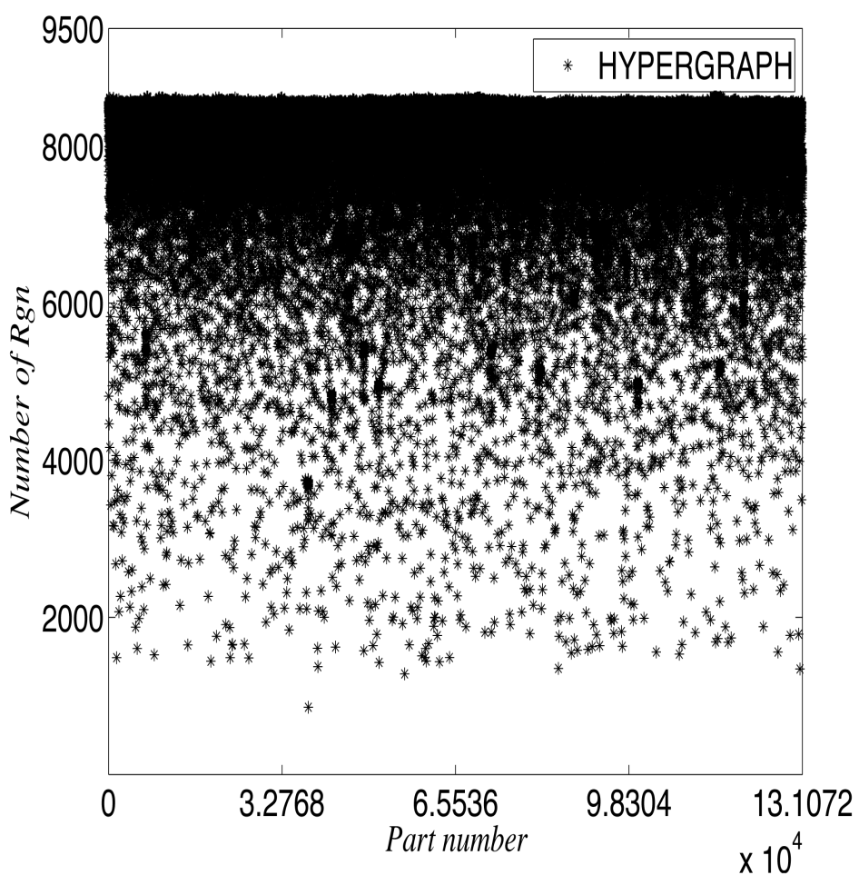
Load Balancing, Dynamic Load balancing
Purpose: Balance or rebalance computational load while controlling communications.
  Equal “work load” with minimum inter-process communications.
FASTMath load balancing tools:
  Jet library is a multilevel graph partitioner
  that runs on a GPU (distributed mesh
  version under development).
  Zoltan/Zoltan2 libraries
  provide multiple dynamic
  partitioners with general control
  of partition objects and weights.
  PUMI-Balance diffusive multi-criteria
  partition improvement.
46

Slide 13
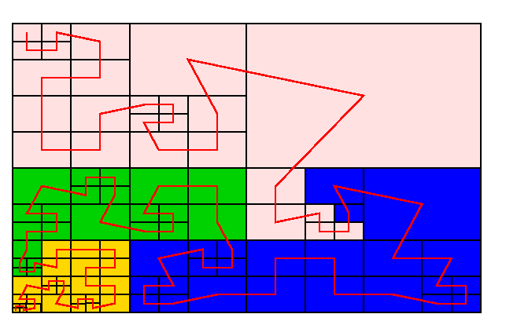
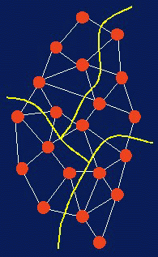
Zoltan/Zoltan2 Toolkits: Partitioners
Suite of partitioners supports a wide range of applications;
no single partitioner is best for all applications.
Geometric
Recursive Coordinate Bisection
Recursive Inertial Bisection
Multi-Jagged Multi-section
Space Filling Curves
Topology-based
PHG Graph Partitioning
Interface to ParMETIS (U. Minnesota)
Interface to PT-Scotch (U. Bordeaux)
PHG Hypergraph Partitioning
Interface to PaToH (Ohio St.)
47

Slide 14
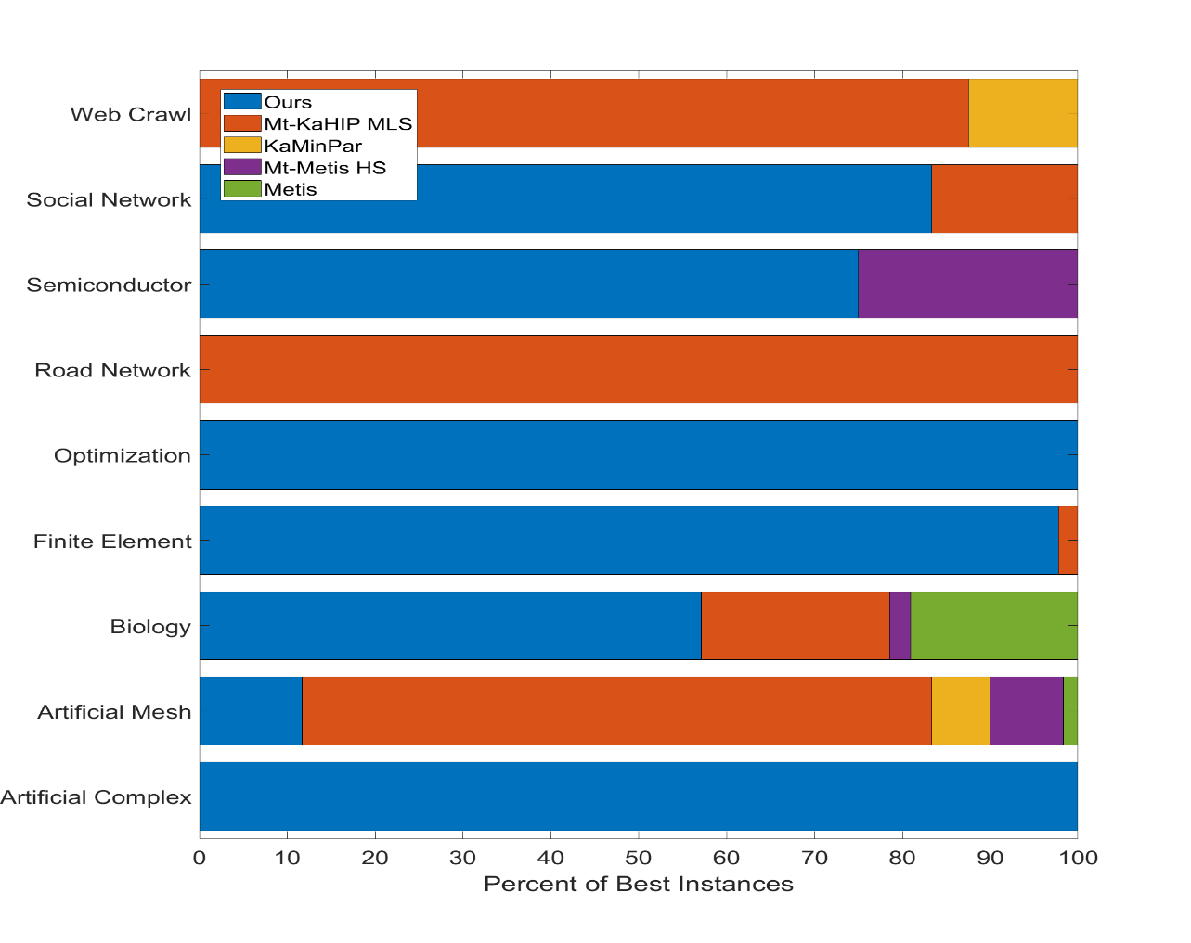
A New Graph Partitioner for GPU: Jet
Multilevel graph partitioner
on GPU.
Uses new label propagation type
refinement algorithm.
Results (blue bars) slightly
better than Metis/Parametis,
but significant speedup due
to GPU execution.
Best partitions for 98% of
the test graphs from finite
element meshes.
Currently single GPU (up to ~1B edges)
Multi GPU - distributed memory version is under development.
48

Slide 15
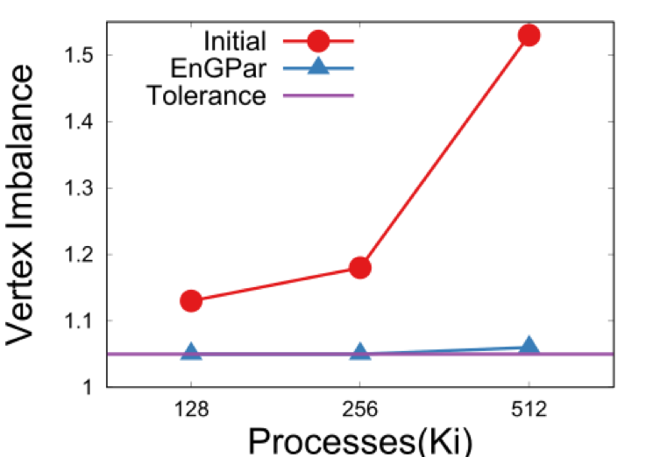
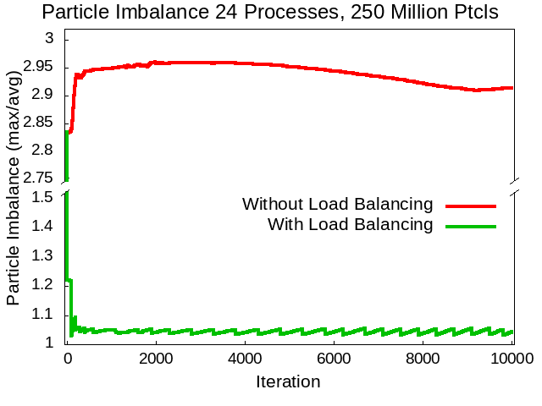
  PUMI-Balance Reduces Hyper-Graph Imbalance
Hyper-graph supports multiple dependencies (edges) between application work/data items (vertices).
Application defined graph vertices
and edges.
Diffusion movement of work from heavily loaded parts to lightly loaded parts.
In 8 seconds, PUMI-Balance reduced a 53% vtx imbalance to 6%, at a cost of 5% elm imbalance, and edge cut increase by 1% on a 1.3B element mesh.
Applied to PIC calculations for particle balance – 20% reduction in run time.
Application of EnGPar particle dynamic load balancing in a GITRm impurity transport simulation
49

Slide 16
Creation of Parallel Adaptive Loops
Parallel data and services used to develop adaptive simulations:
Geometric model topology for domain linkage.
Mesh topology – it must be distributed.
Simulation fields distributed over geometric model and mesh.
Partition control.
Dynamic load
balancing required
at multiple steps.
API’s to link to:
  CAD/Geometry
  Mesh generation
  and adaptation.
  Error estimation.
  Field transfer.
Physics and Model Parameters
Input Domain Definition with Attributes
Solution transfer constraints
non-manifold
model construction
meshing
operation
Mesh Generation and/or Adaptation
Solution
Transfer
geometric
interrogation
PDE’s and
discretization
methods
meshes and fields
mesh size
field
mesh
Attributed
topology
Complete Domain Definition
Parallel Data & Services
mesh size
field
Correction Indicator
Domain Topology
Mesh Topology/Shape
geometry updates
mesh with fields
Simulation Fields
Mesh-Based Analysis
Partition Control
Postprocessing/Visualization
Dynamic Load Balancing
mesh with fields
calculated fields
50

Slide 17
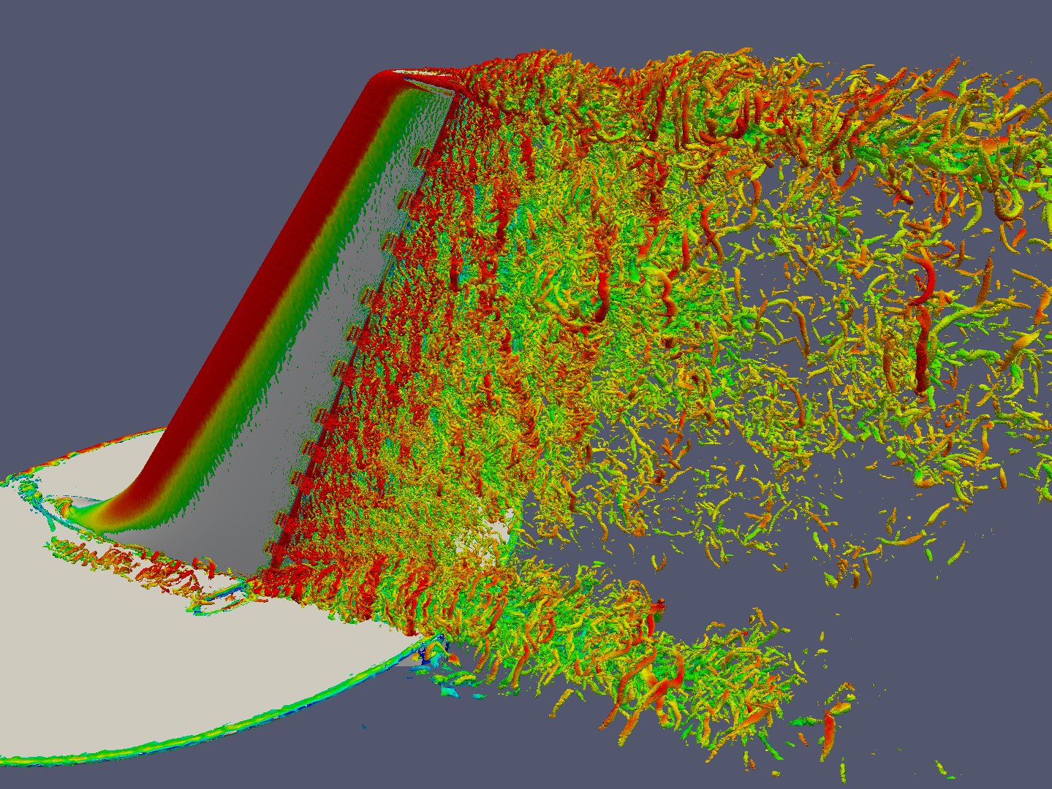
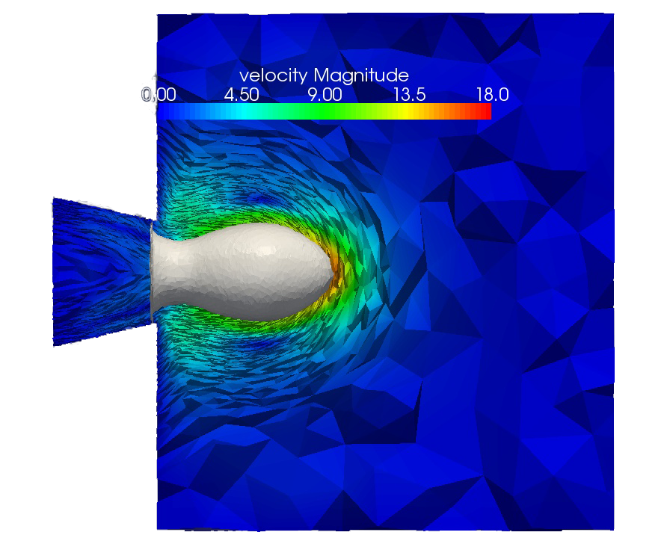
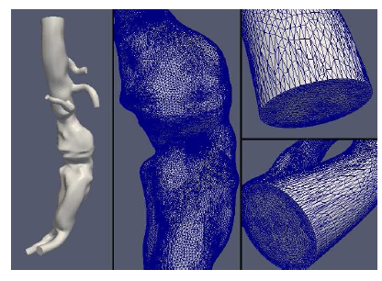
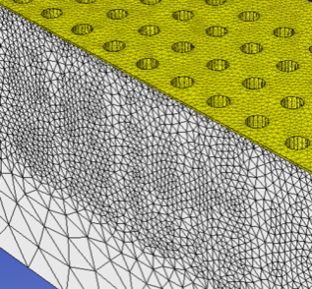
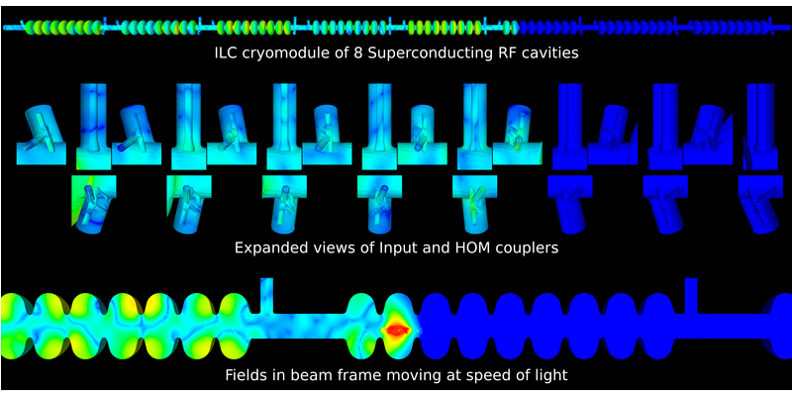
Parallel Adaptive Simulation Workflows
In memory adaptive loops support effective data movement.
In-memory adaptive loops for:
  MFEM – High order
  FE framework
  PHASTA – FE for NS
  FUN3D – FV CFD
  Proteus – multiphase FE
  Albany – FE framework
  ACE3P – High order FE
  electromagnetics
  M3D-C1 – FE based MHD
  Nektar++ – High order FE flow
  Application of active flow control to aircraft tails
  Blood flow on the arterial system
  Fields in a particle accelerator
51

Slide 18
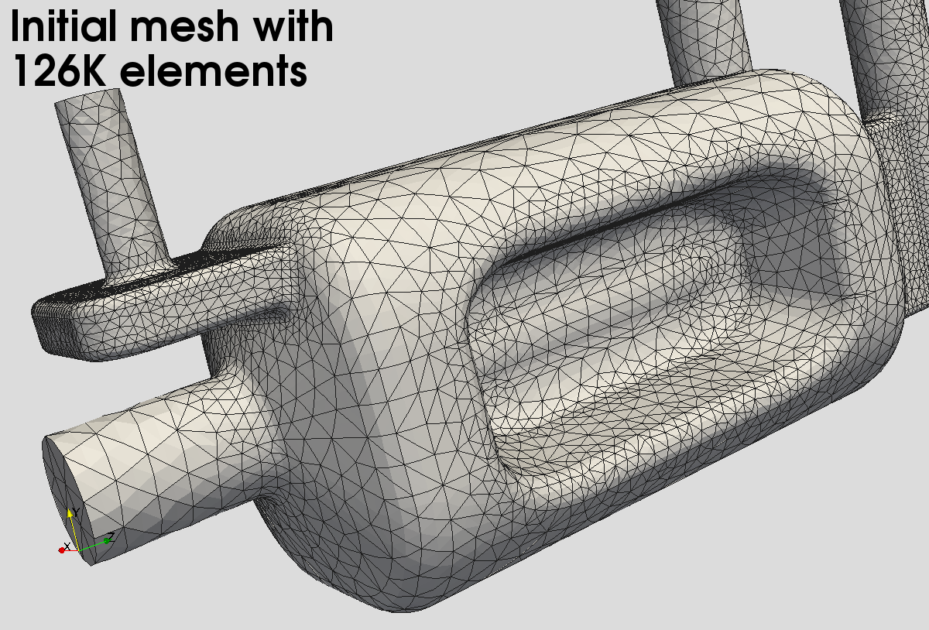
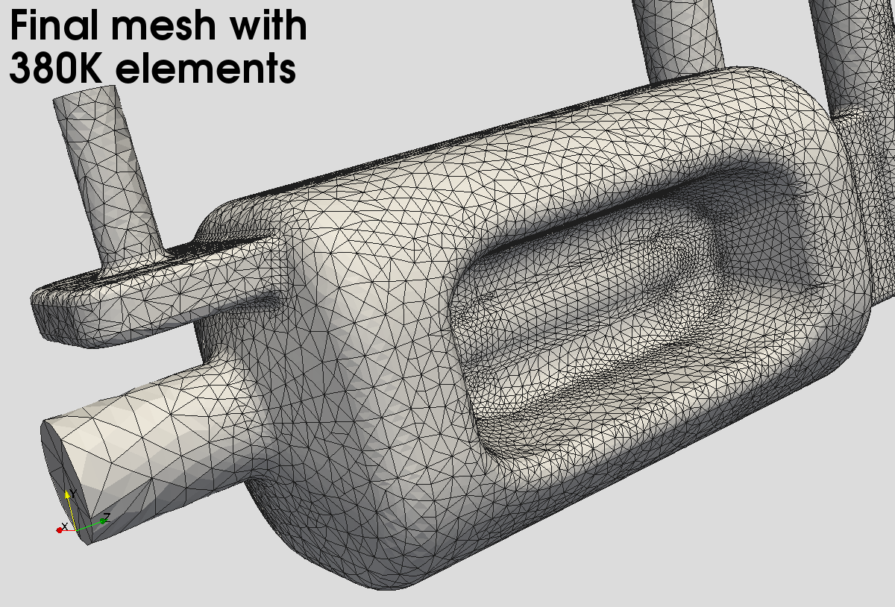
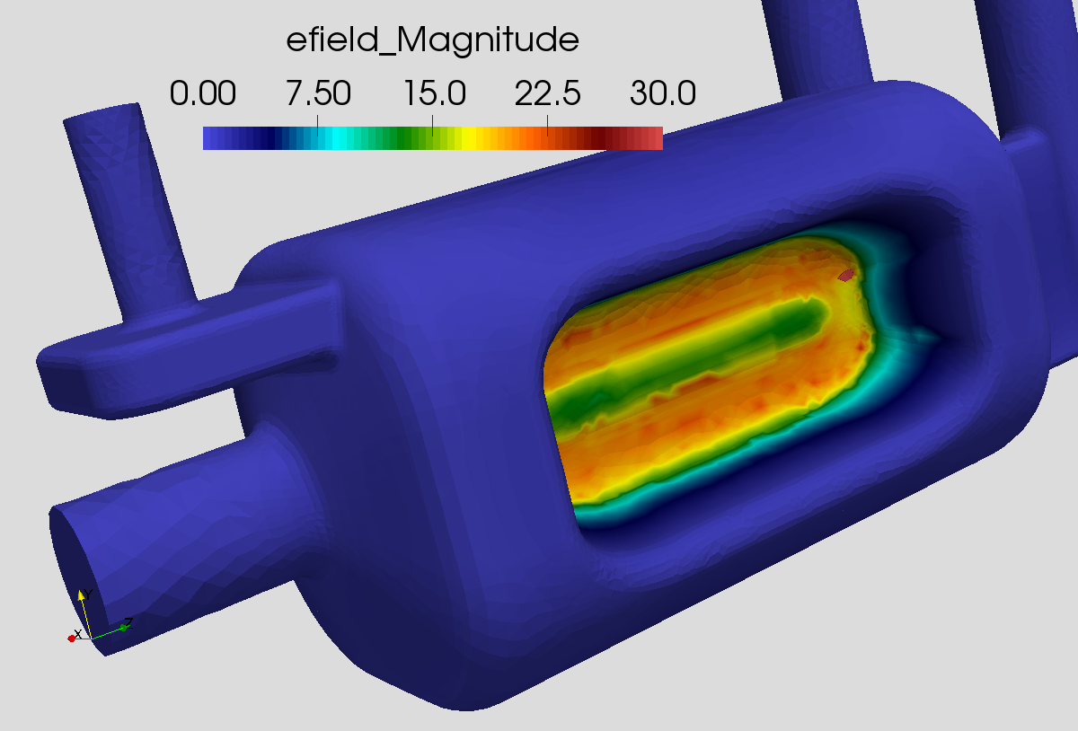
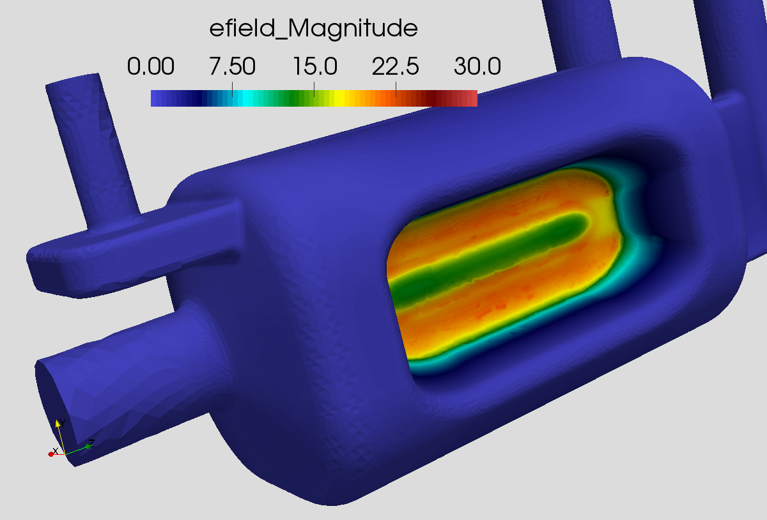
Application interactions – Accelerator EM
Omega3P Electro Magnetic Solver (second-order curved meshes)
This figure shows the adaptation results for the CAV17 model. (top left) shows the initial mesh with ~126K elements, (top right) shows the final (after 3 adaptation levels) mesh with ~380K elements, (bottom left) shows the first eigenmode for the electric field on the initial mesh, and (bottom right) shows the first eigenmode of the electric field on the final (adapted) mesh.
52

Slide 19
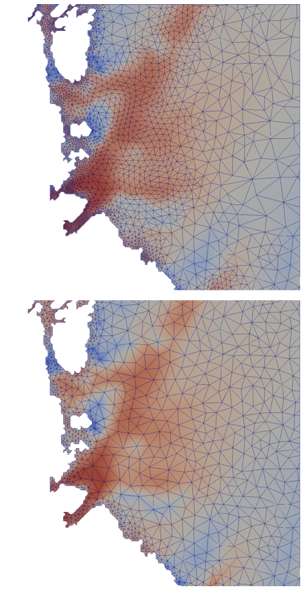
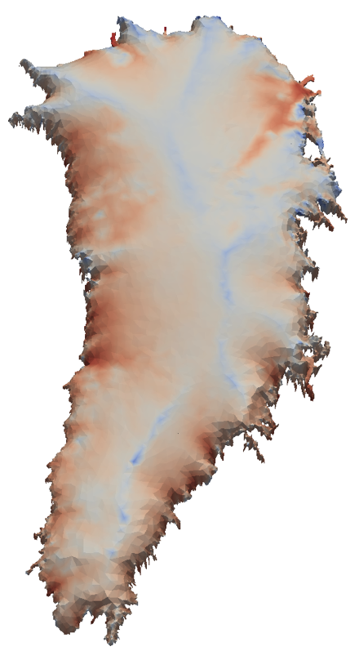
Application interactions – Land Ice
FELIX, a component of the Albany framework is the analysis code.
PUMI-Perfromant-Adapt parallel mesh adaptation is integrated
with Albany to do:
  Estimate error.
  Adapt the mesh.
Ice sheet mesh is modified to minimize degrees of freedom.
Field of interest is the ice sheet velocity.
53

Slide 20
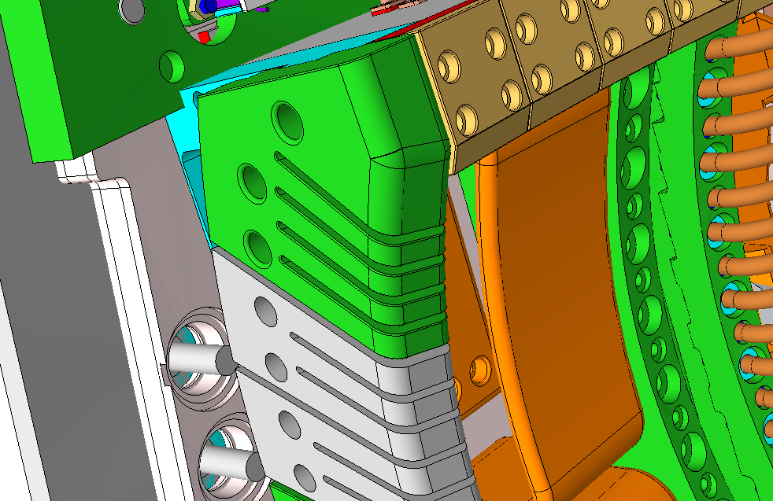
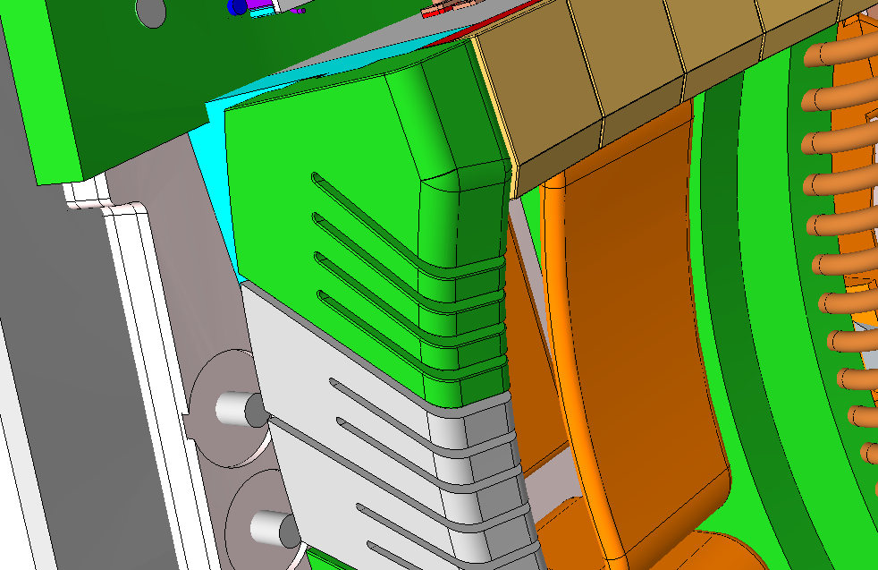
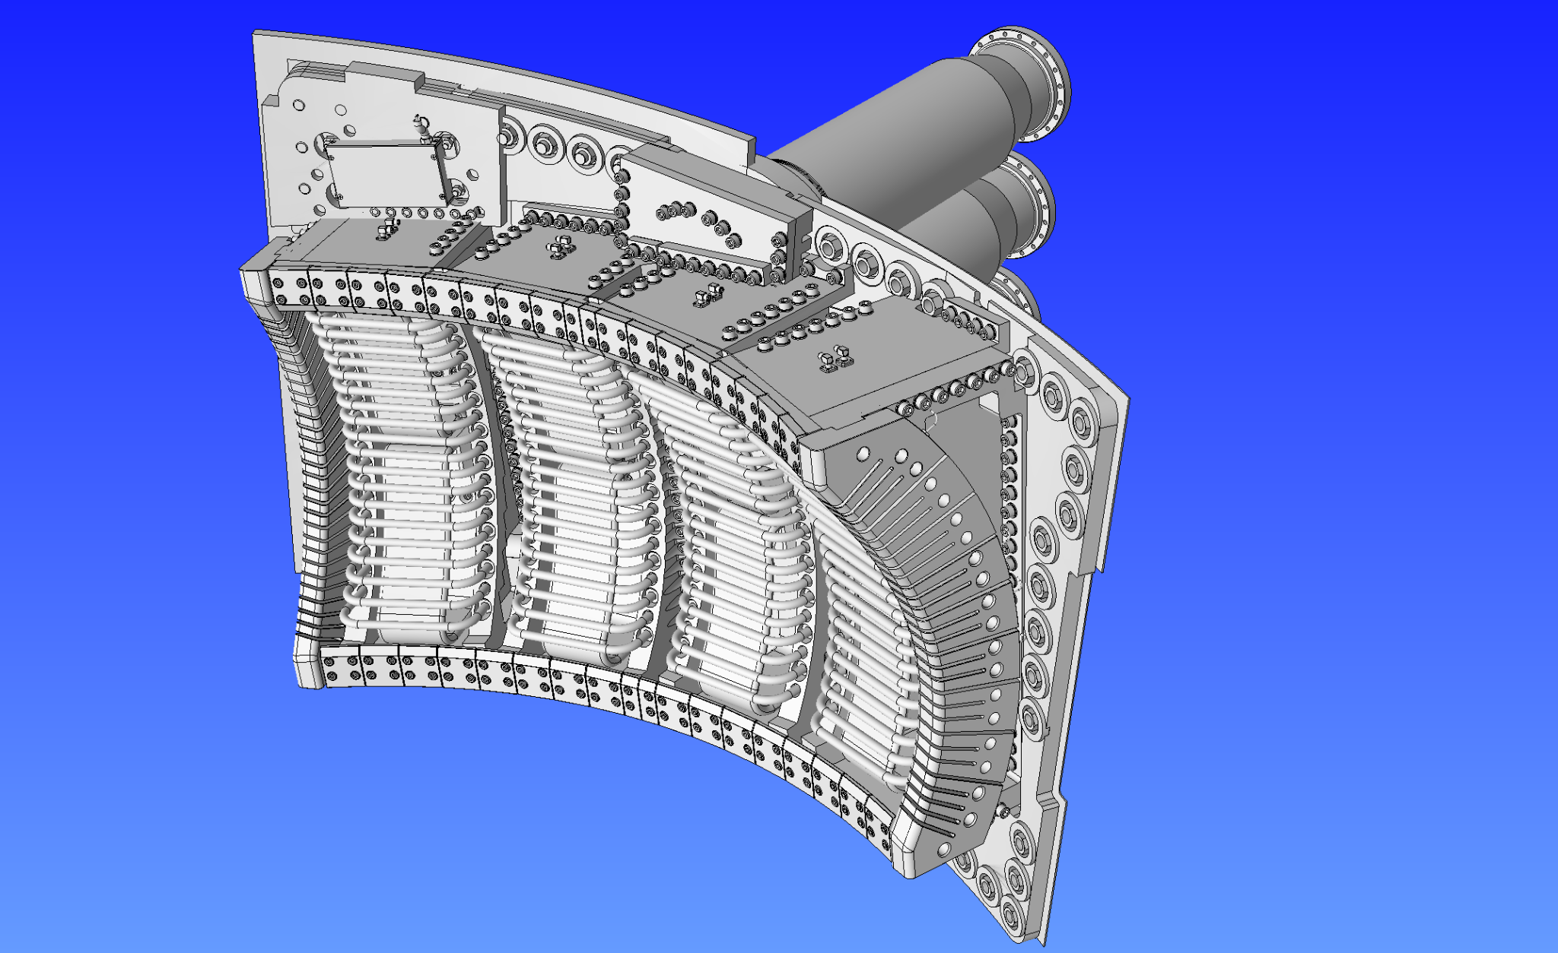
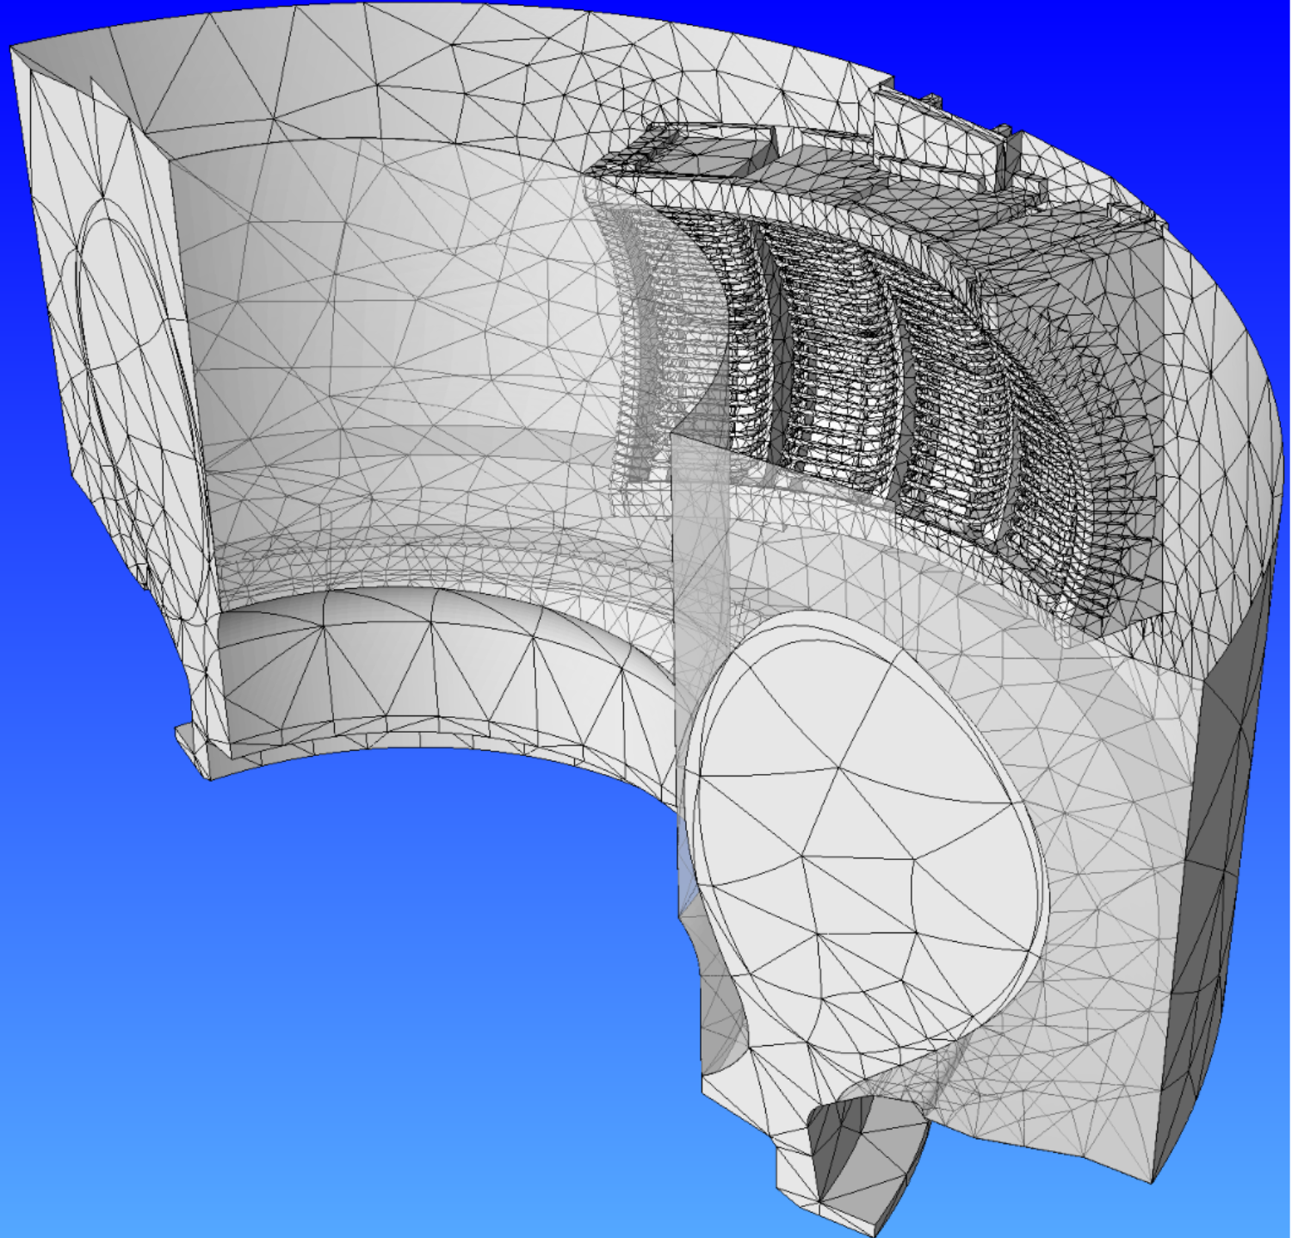
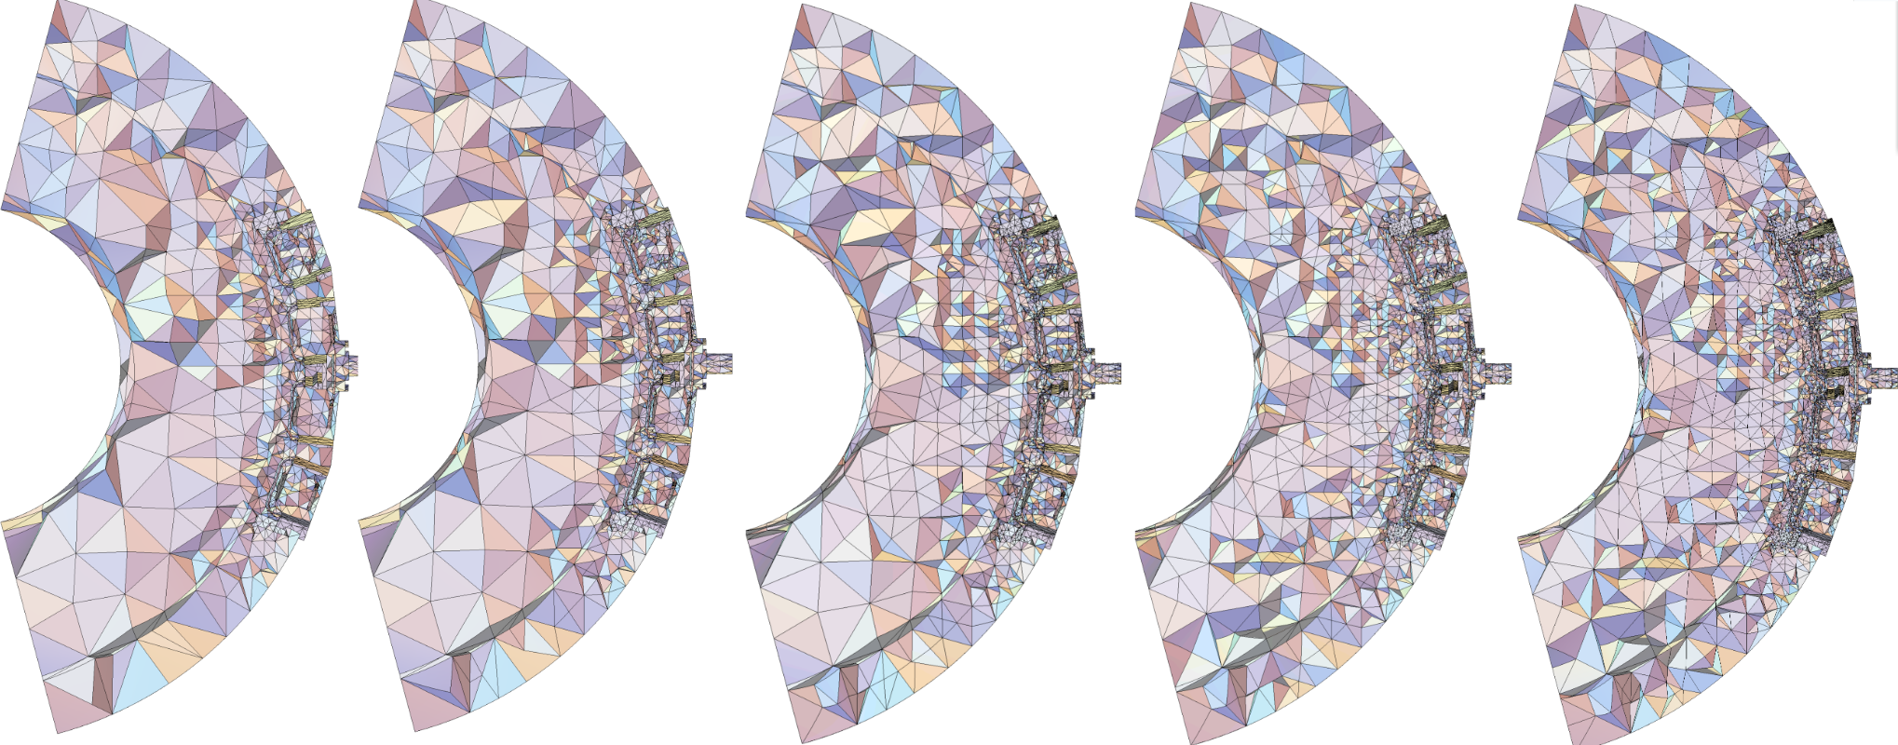
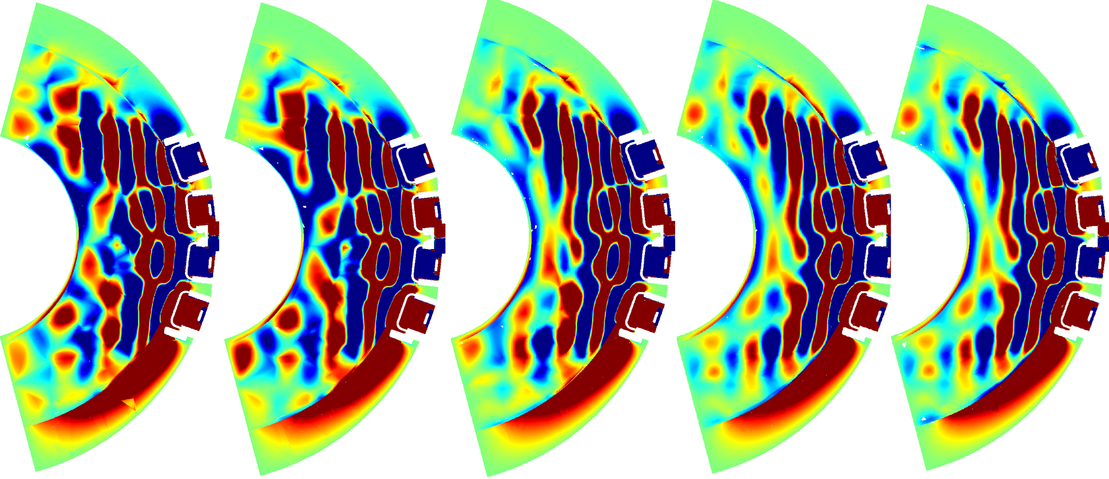
Application interactions – RF Fusion
Accurate RF simulations require:
  Detailed antenna CAD geometry.
  CAD geometry defeaturing.
  Extracted physics curves from
  GEQDSK equilibrium file.
  Analysis geometry combines
  CAD, and physics geometry.
  3D meshes for accurate FE
  calculations in MFEM.
  Projection based error
  estimator.
  Conforming mesh
  adaptation with PUMI.
  Fast elimination of unwanted features
Defeatured antenna in curved mesh
CAD of antenna array
Initial Mesh
Final Adapted Mesh
54

Slide 21
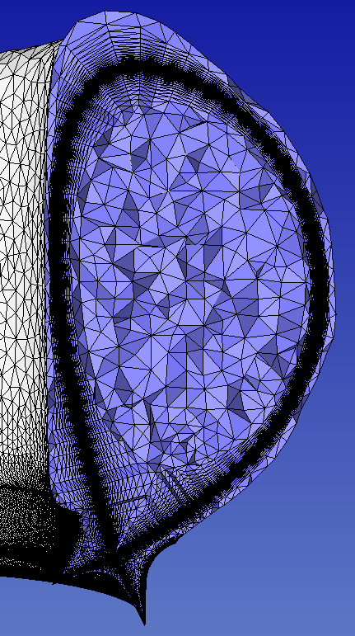
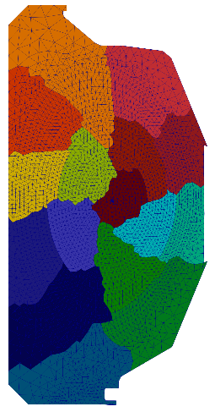
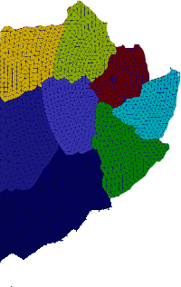
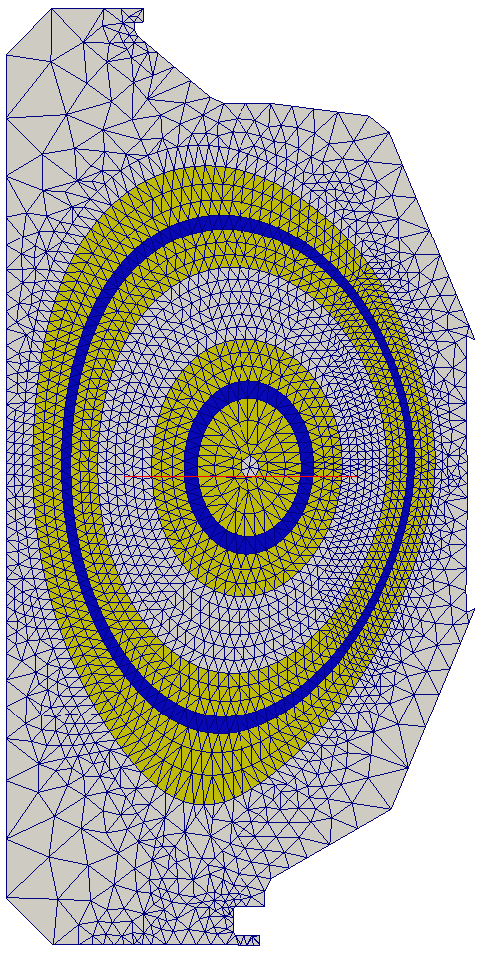
Supporting Unstructured Mesh for Particle-in-Cell Calculations
PUMI-Pic data structures are mesh centric:
  Mesh is distributed as needed by the
  application in terms of PICparts.
  Mesh can be graded and anisotropic.
  Particle data associated with elements.
  Operations take advantage of
  distributed mesh topology.
  Mesh relation to geometry used to speed calculation for near surface physics.
  Mesh distributed in PICparts:
    Start with a partition of mesh into a
    set of “core parts”.
    A PICpart is defined by a “core part”
    and sufficient buffer to keep particles
    on process for one or more pushes.
Particle Push
(update x, v)
Field to Particle
(mesh → particle)
Charge Deposition
(particle → mesh)
Field solve on mesh
A PICPart with
part buffers.
3D mesh
(with high anisotropy)
Upper: PICpart more for random particle motion.
Lower: Two PICparts for field following particles
55

Slide 22
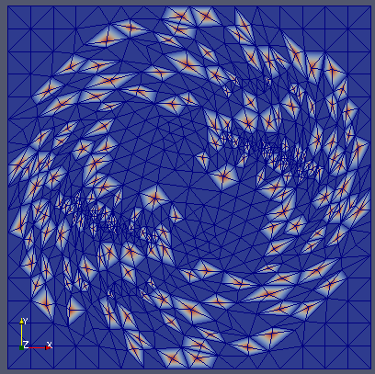




Mesh Data Structure for Heterogeneous Systems
Mesh topology/adaptation tool –
PUMI-Portable-Adapt:
  Conforming mesh adaptation (coarsening past initial mesh, refinement, swap).
  Manycore and GPU parallelism using Kokkos.
  Distributed mesh via mesh partitions with MPI communications.
  Support for mesh-based fields.
  Curved mesh adaptation.
  Efficient field storage.
  Kokkos implementation on
  latest NVIDIA, AMD and
  Intel GPUs.
Adaptation following rotating flow field.
Mesh entity adjacency arrays.
Serial and RIB partitioned mesh of RF antenna and vessel model.
56

Slide 23

PUMI-Pic Particle Data Structures
Layout of particles in memory is critical to performance:
  Optimizes push (sort/rebuild), scatter, and gather operations.
  Associate particles with elements for large per element particle cases.
  Support changes in the number of particles per element.
  Evenly distributes work under a range of particle distributions
  (e.g. uniform, Gaussian, exponential, etc.).
  Stores a lot of particles per GPU – low overhead.
Particle data structure interface and implementation:
  API abstracts implementation for PIC code developers.
  CSR, Sell-C-σ, CabanaM, DPS.
  Performance is a function of
  particle distribution.
  Cabana AoSoA w/a CSR index of
  elements-to-particles are promising.
  DPS particle structure for low
  particle density applications.
Left to Right: CSR, SCS with vertical slicing (yellow boxes), CabanaM (red boxes are SOAs). C is a team of threads.
57

Slide 24


PIC Operations Supported by PUMI-Pic
  Particle push.
  Adjacency based search
    Faster than grid based search.
  Element-to-particle association update.
  Particle Migration.
  Particle path visualization.
  Mesh partitioning w/buffer regions.
  Mesh field association.
  Fast construction of elements within given distance of mesh faces on model surface.
  Poisson field solve using PETSc DMPlex on GPUs.
2020 PUMIPic Paper: https://www.scorec.rpi.edu/REPORTS/2020-2.pdf
58

Slide 25



PUMI-Pic based XGCm Edge Plasma Code
XGCm is a version of XGC built on PUMI-Pic:
  All operations on GPUs – push, gather/scatter, etc.
Testing of PUMI-Pic for use in XGC like push:
  2M elements, 1M vertices, 2 to 128 poloidal planes.
  Pseudo push and particle-to-mesh gyro scatter.
  Tested on up to 24,576 GPUs with 1.1 trillion particles, for 100 iterations: push, adjacency.
  PUMI-Pic weak scaling up to 24,576 GPUs (4096 nodes) with 48 million particles per GPU.
  Total time comparison:
  Ran on NERSC’s Perlmutter.
  XGCm 3 times faster than XGC for adiabatic electron case, 21% faster for
  kinetic electron case.
59

Slide 26






PUMIPic based GITRm Impurity Transport Code
Incorporates impurity transport capabilities of GITR.
3D mesh for cases including divertors, tiles, limiters,
specific diagnostics/probes etc.
Status:
  Physics equivalent to GITR.
  Efficient Multi-species capabilities.
  Anisotropy mesh for accurate field transfer.
  Field transfer from SOLPS to 3D mesh.
  Non-uniform particle distribution
  – evolves quickly in time.
  Load balancing particles via PUMI-Balance.
  Distance to boundary for sheath E field.
  Post-processing on 3D unstructured mesh.
Probes
60

Slide 27


PUMI-Tally - GPU Acceleration of Monte Carlo Tallies
Builds on PUMI-PIC core to support mesh-based tallies.
Implements track length tallies.
  Sum weighted length of moves.
Batch the particles for data parallel.
Tested on both GPU and CPU’s.
Compared to OpenMC implementation
(does not batch particles):
  19.7 times faster on and NVIDIA A100.
  9.2 times faster using OpenMP on two AMD EPYC 7763 CPUs.
  Field transfer from SOLPS to 3D mesh.
  GPU version demonstrated a 6.7 times improvement in energy consumption.
Computation Time
Energy consumption
61

Slide 28
Parallel Coupler for Multimodel Simulations (PCMS)
  Goals of PCMS:
  Keep applications clean. Only modification to application codes is access its data structures.
  General structures and functions for coupling operations.
  Make effective use of the massively parallel, heterogeneous computing systems.
Multiscale Simulation Specification
Data in App A format
EFFIS 2.0
App A Parameters and description of structures
App B Parameters and description of structures
Data in App B format
Unmodified App A Routines
App A data
Coupler
App B data
Unmodified App B Routines
Setup and parameter evaluation added
Convert data to/from
Coupler / App A
Convert data to/from
Coupler / App B
Setup and parameter evaluation added
ADIOS2
ADIOS2
ADIOS2
ADIOS2
App B data
App A data

Slide 29

In-Memory Coupling of Fusion Codes
Each application solves its model(s) over a portion of the domain.
The domains overlap: The overlap can
include three subregions.
The blended region in which the fields are
coupled based on a field blending strategy.
A buffer region for Application A (edge) in
which the “right” end boundary conditions
are determined by Application B (core)
and/or source terms added.
A buffer region for Application B (core) in
which the “left” end boundary conditions are
determined by Application A (edge) and/or
source terms added.
Red curves are flux
curves used to
define region
boundaries
Ω_{edge}
Γ_{edge}
_{given by core∫}
Ω_{core}
Γ_{core}
_{given by edge∫}
Ω_{AppA}
AppA
buffer
Γ_{AppA}
given by AppB
Blended
Γ_{AppB}
given by AppA
Ω_{AppB}
AppB
buffer
Blended
ξ
ξ=0
ξ=1
63

Slide 30

“Rendezvous” Algorithm to Control Coupler Domain Partition
Challenge:
The coupled applications need to control their domain partitioning
to meet their specific needs.
Approach:
Coupling applications A and B, each of which has it own partitions.
Rendezvous algorithm uses a third partition to coordinate data transfers between the applications.
“Rendezvous” algorithm “enables scalable algorithms which are most useful when processors neither know which other processors to send data to, nor which other processors will be sending data to them”.

Slide 31








Example Field Transfer with RBF on LCPP
XGC mesh with 611,359 elements and 306, 002 nodes
$idensity$ loaded as the exact/initial field in the coupler app
$idensity$ after 10 MLS-RBF interpolation operation: cell to node and node to cell in each iteration. $ρ=0.007$
$idensity$ error field after 10 MLS-RBF interpolation operation: cell to node and node to cell in each iteration. $ρ=0.007$
$$\text{error} =\log_{10}\left|f_{i}−g_{i}\right|$$

Slide 32

In Situ Machine Learning During Simulations
Simulation data too large to save
=> need Online Machine Learning.
Dynamic PDE data stream provides more and better training data.
Training using Smartsim/SmartRedis.
Clustered and co-located deployment of components utilizing CPU and/or GPU.
Scalable: negligible overhead on simulation
Data parallel training with Horovod
and PyTorch DDP.
No dependency on analysis code/ARCH
(tested with PHASTA (legacy) and
libCEED (ECP) on Aurora and Polaris).
Online training with user
interactive script
R.Balin et al., In Situ Framework for Coupling Machine Learning with Application to CFD, https://doi.org/10.48550/
arXiv.2306.12900
66

Slide 33




Mesh Related AI/ML Developments
Robust feature detection/processing:
Physics-based and AI/ML sensors: neural network processes fragmented/noisy data.
Application: anisotropic diffusion transport in fusion devices, ground line dynamics in ice sheets.
Physics informed material models
Machine learned constitutive models can reduce runtime cost of upscaling FEM simulations by orders of magnitude while retaining 80% of accuracy.
ML Agents for automated hex meshing
Reinforced learning agent decomposes
CAD modes into regions suitable for
hexahedral mesh generation.
Improve sensor data
multiscale
ML
Comparing ML to Multiscale
67

Slide 34

Run the latest Simmetrix and PUMI software on RPI systems
We will help you run the latest Simmetrix and PUMI model preparation, mesh generation, and adaptation tools on your problem using HPC systems at RPI.
Contact Cameron Smith in Slack, during Speed-Dating, or via email at smithc11@rpi.edu for more information.
68

